Slide 1
Jenkins and spring boot project tech stack = maven, spring boot ,docker , Jenkins by Akshit parmar

Slide 2
Intro
Spring Boot Initializer is an online tool that simplifies the creation of a new Spring Boot project by generating a customizable project structure with necessary dependencies and configuration files
Maven is a build automation and project management tool used primarily for Java projects ,it use pom.xml file for file dependencies
Docker is a platform that automates the deployment, scaling, and management of applications using containerization, allowing applications to run consistently across different computing environments.
Jenkins is an open-source automation server used for continuous integration and continuous delivery (CI/CD), enabling developers to automatically build, test, and deploy code changes in a consistent and efficient manner.

Slide 3
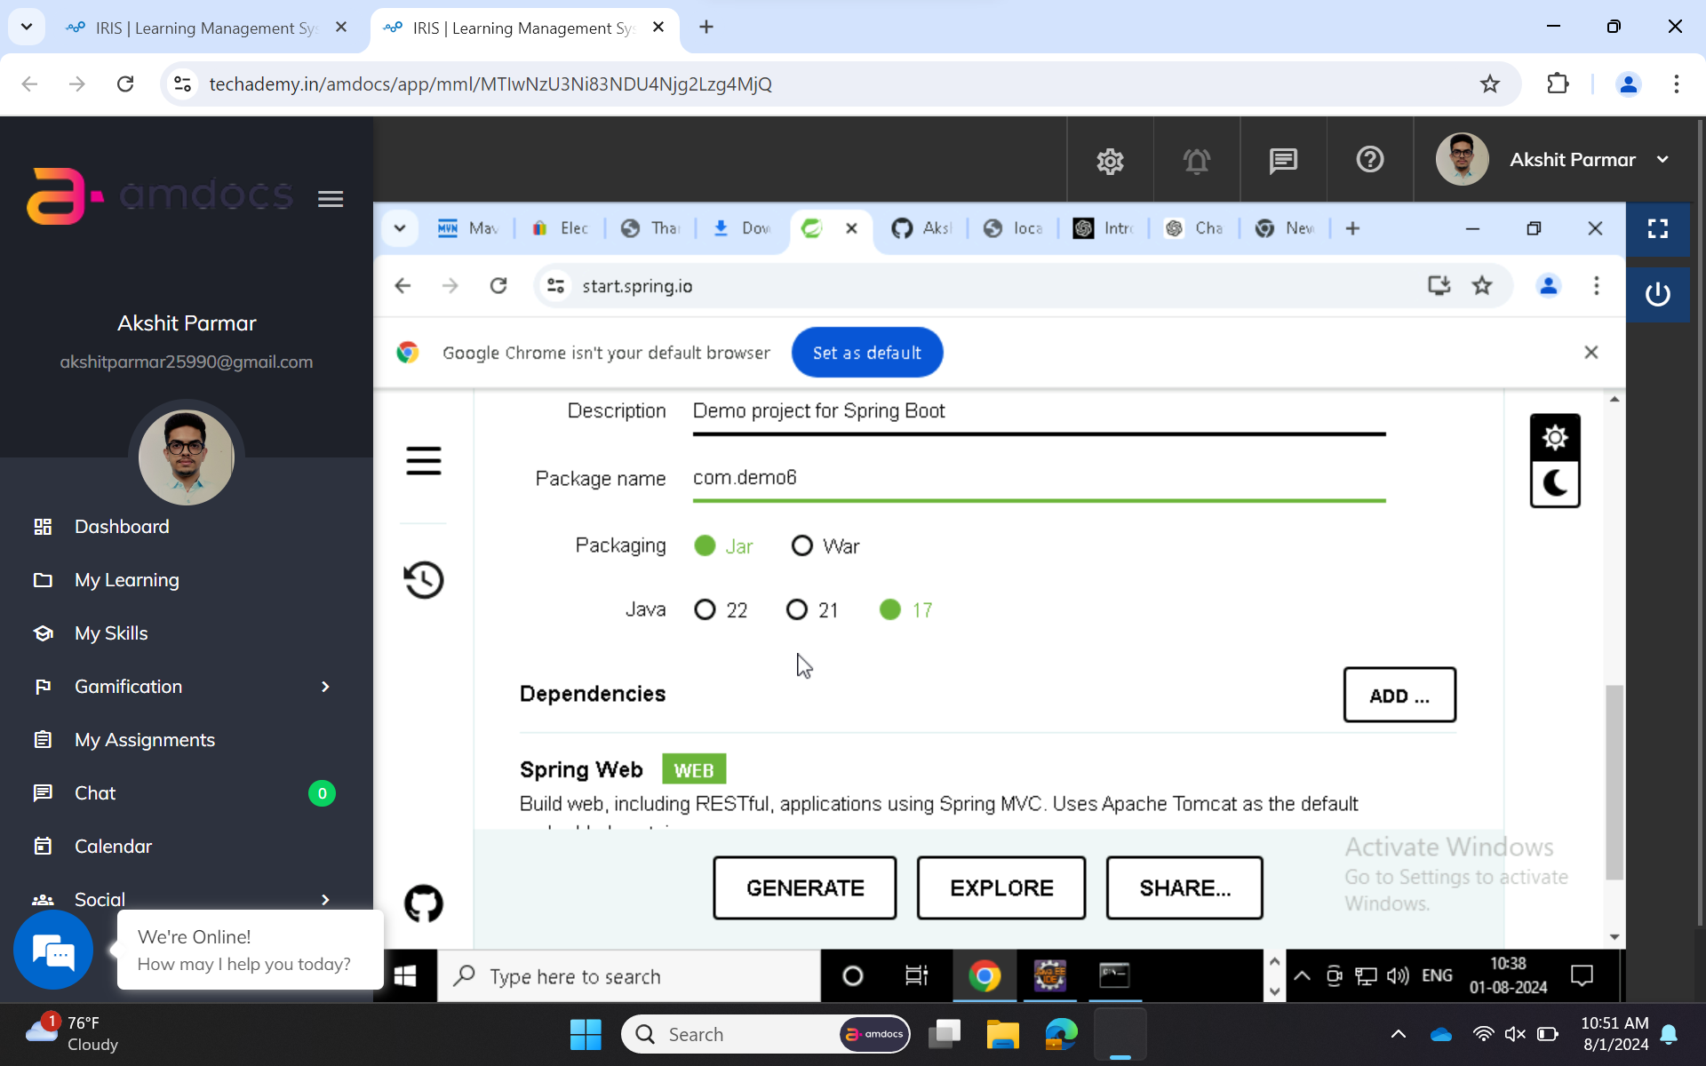
Spring boot initializer

Slide 4
After importing project into eclipse ide
File -> import- > maven project->existing maven project

Slide 5
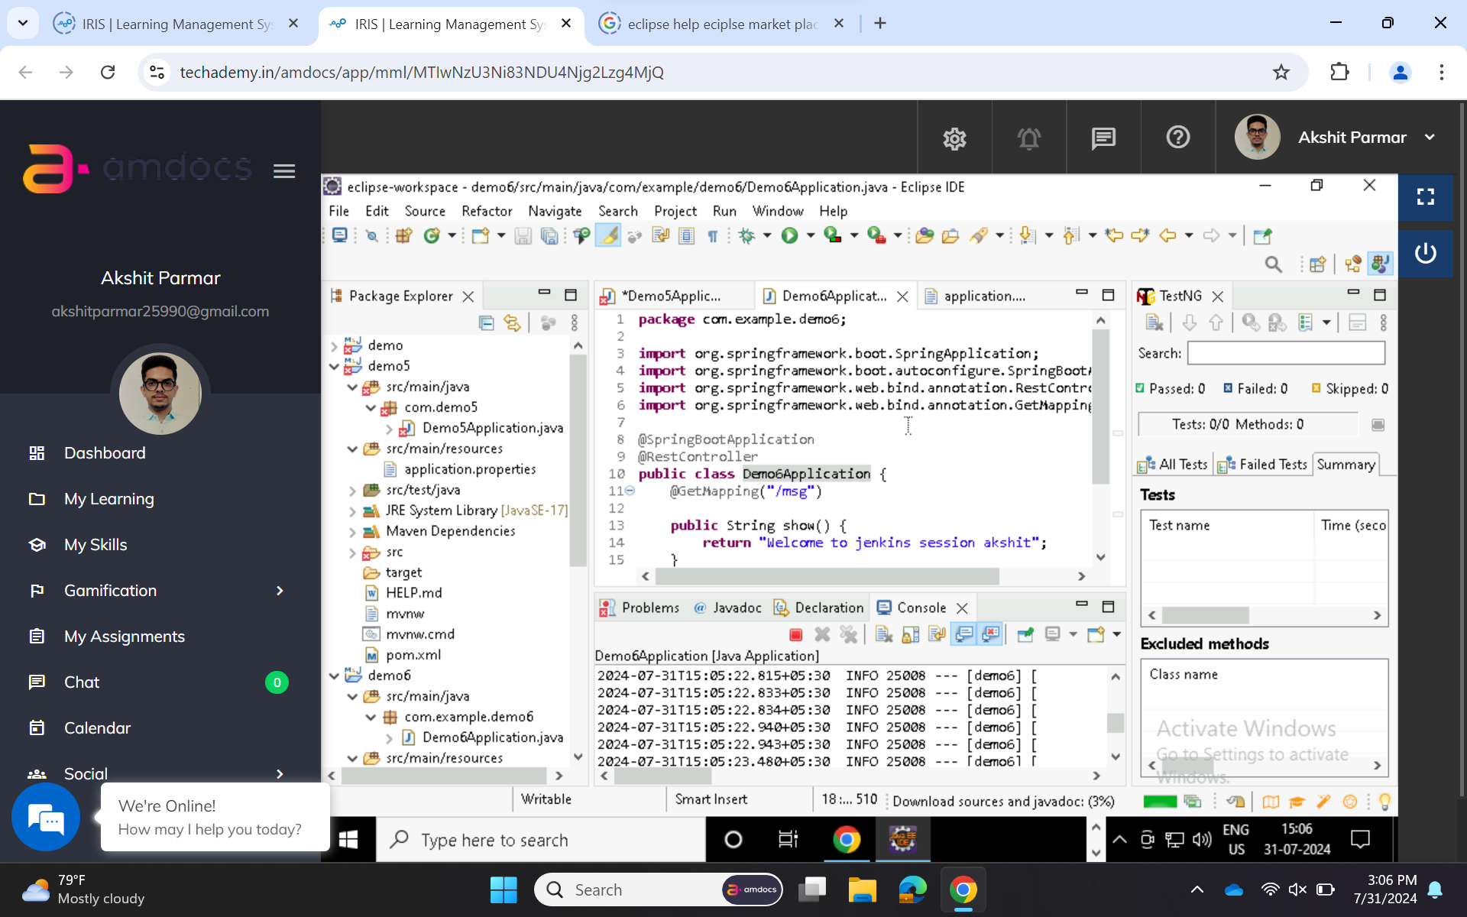
Java test program in demo6application file

Slide 6
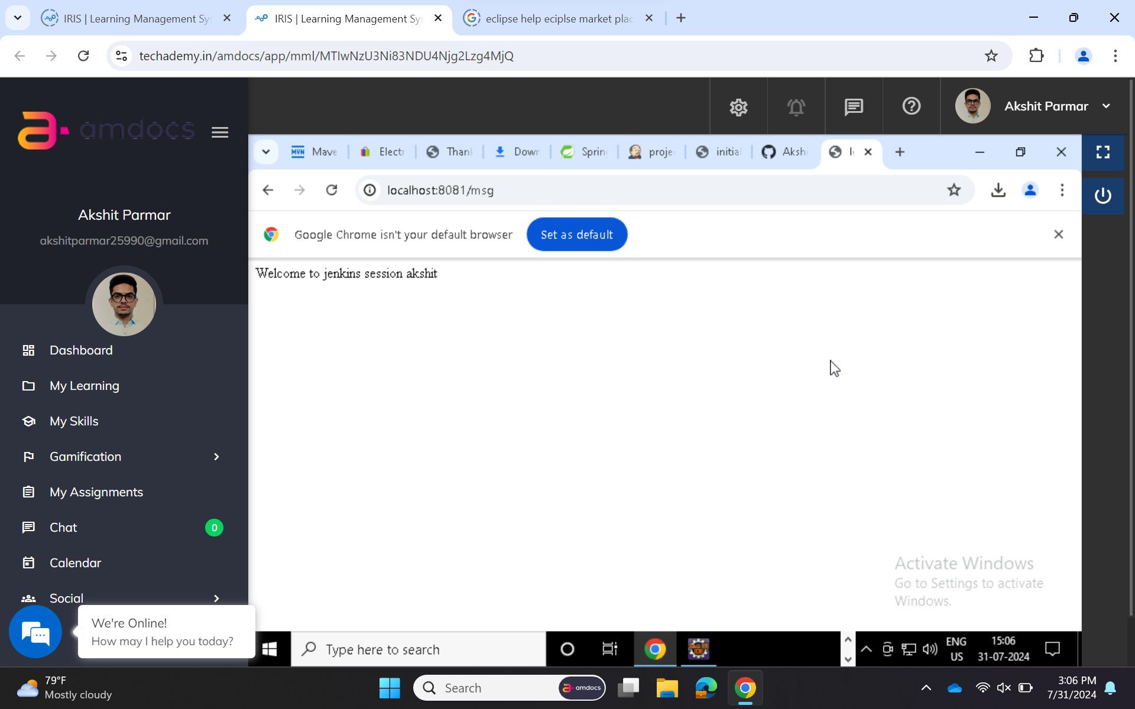
Run java application and output

Slide 7
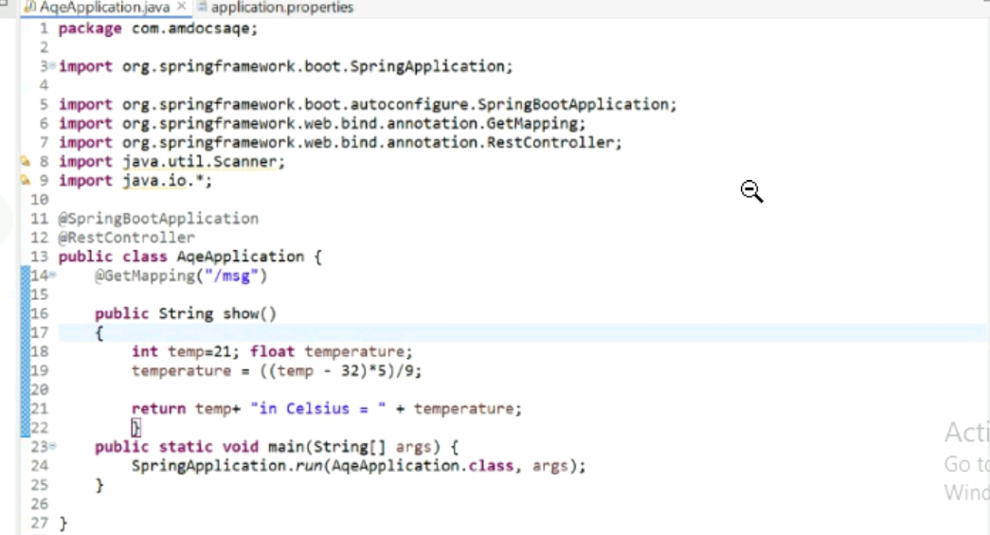
Other program

Slide 8
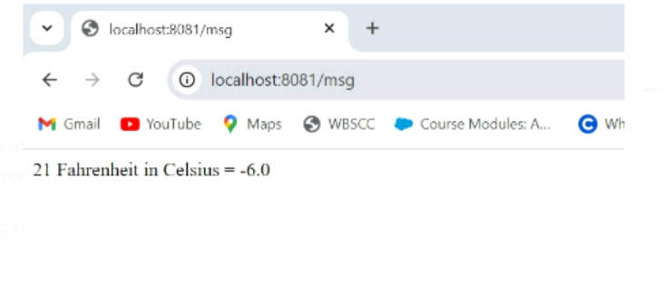
Its output on local host

Slide 9
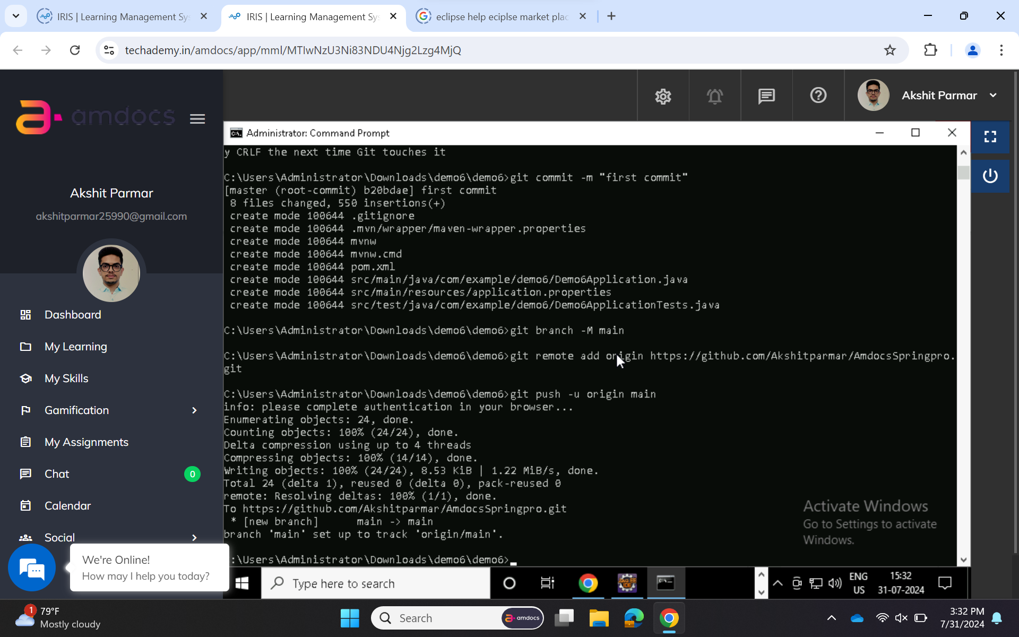
Pushing the program to the github

Slide 10
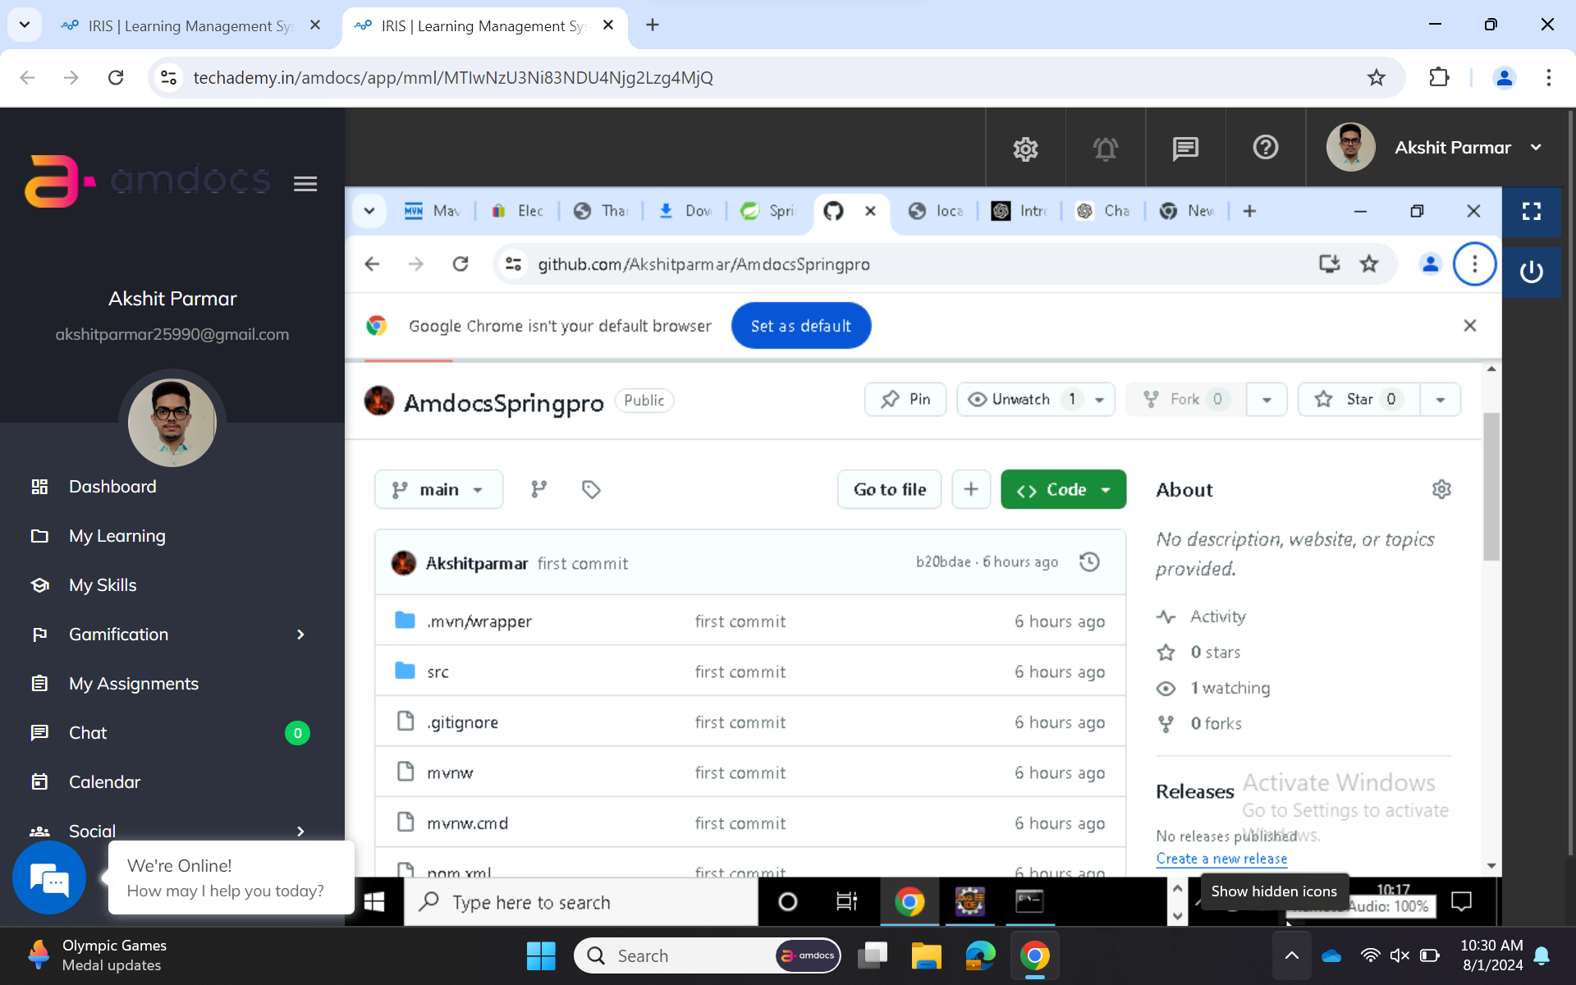
After running all git commands .The code will be pushed

Slide 11
Setup Jenkins after installing it add credentials and use source as git so that we can get connectivity from github

Slide 12
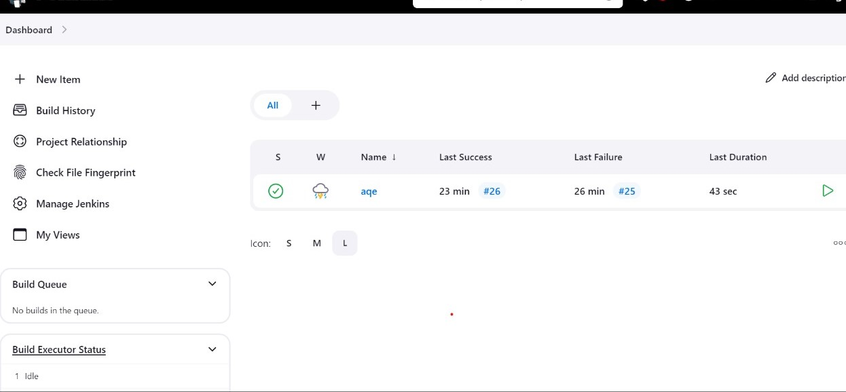
Jenkins status

Slide 13
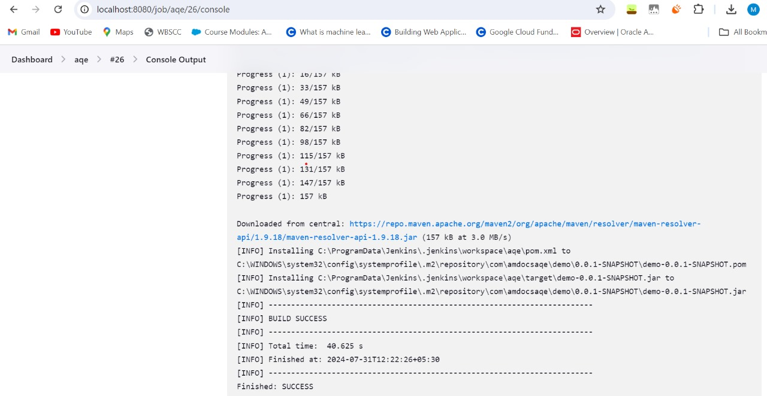
Successful Jenkins build
Enhancing your presentation

Slide 14
Creating .jar file
->right click on project name then run as maven install
Then the jar file will get download

Slide 15
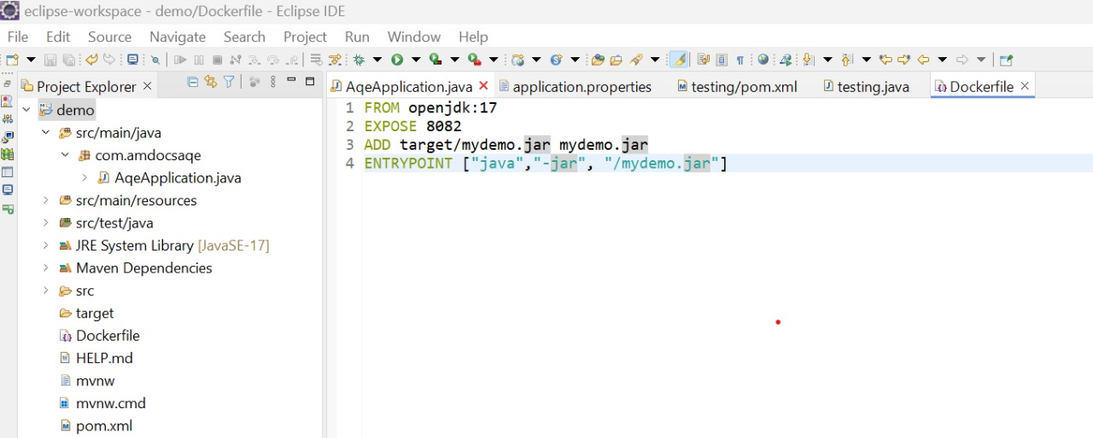
Dockerizing the application dockerizing is basically running a project in any environment project->new file ->filename(it is casesensitive) write in docker file a dockerfile is a script containing a series of instructions for building a docker image

Slide 16
Docker file content
Form : basically it specifies the base image for the docker image you are building.every dockerfile must begin with a from instruction.
Expose: indicates the port on which the container will listen for network connections at runtime.
Add: copies files or directories from the host machine into the docker image.
Entrypoint : it basically defines the commands that will run when the container starts
It sets the container to automatically run the specified java jar file when it starts.

Slide 17
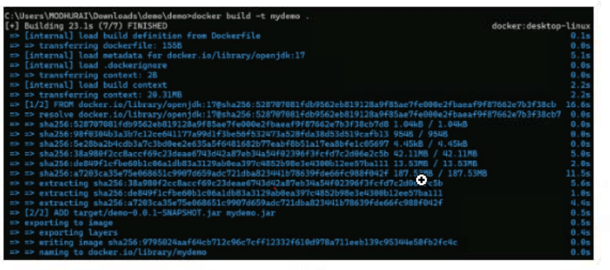
Docker commands to build image
Build docket image
docker build –t mydemo
Run docker container
docker run –p 9090:8082 mydemo
running a docker image will
become a container

Slide 18
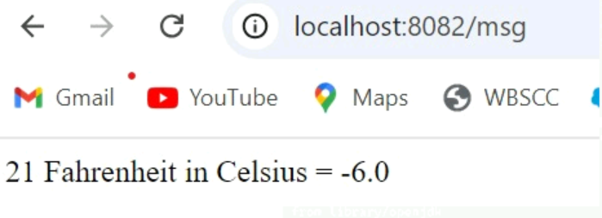
Accessing web page through docker port

Slide 19
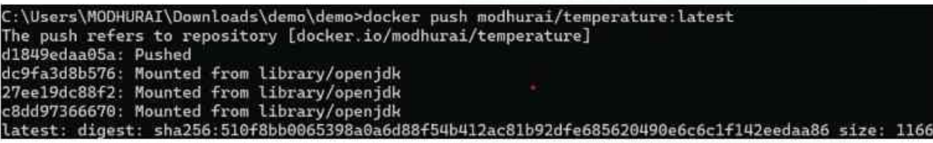
Pushing it to the docker hub
Login into docker -> tag the docker image-> push the Image to docker hub

Slide 20
Thank you

